Slide 1

Project 3
Facebook Advertising – Customer Segmentation
Nour Amous
Shane Carmichael

Slide 2
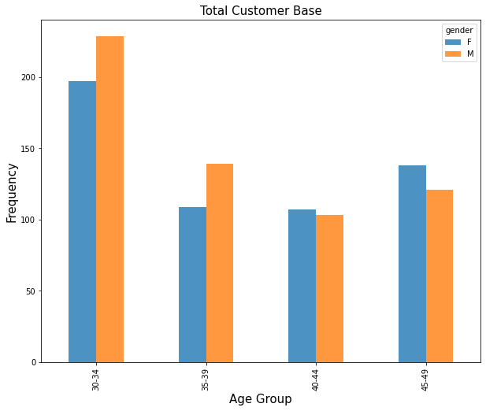
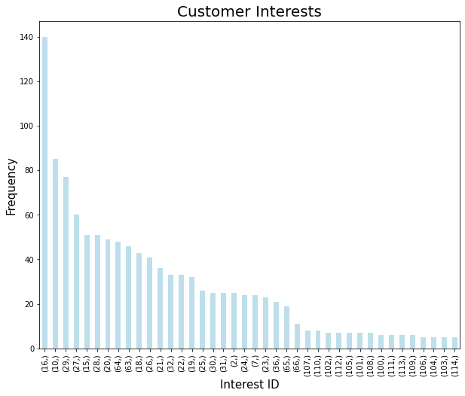
Executive Summary
Dataset: Facebook Advertising Data
Strategy: Targeted advertising to customer segments
Modelling: K Means Clustering
Result: Increase Sales by over 60%
EDA and Features
Age, Gender, Interests

Slide 3
Background - Facebook Advertising
Business’s define a ‘target audience’ that they wish their advertisements to be displayed to.
Business’s set a daily or lifetime budget for the advertisement
Costs are incurred for each ‘impression’ and ‘click through’
‘Approved Conversions’ (sales) can be tracked using a ‘Facebook pixel code that is added to the retailers website
Facebook determines user interests based on their previous activity and pages in which they have already followed
The business should optimise the value of the Facebook advertising budget by choosing a target audience that is more likely to purchase their product
Notes:
Interests are highly important for your Facebook ad campaigns for a few reasons. They allow you to target people that are specifically interested in a certain subject related to your product. For example, you could target people interested in your competitors or specific publications covering your target market. The possibilities are endless, but it’s important that you test different interest groups and see what responds best.

Slide 4
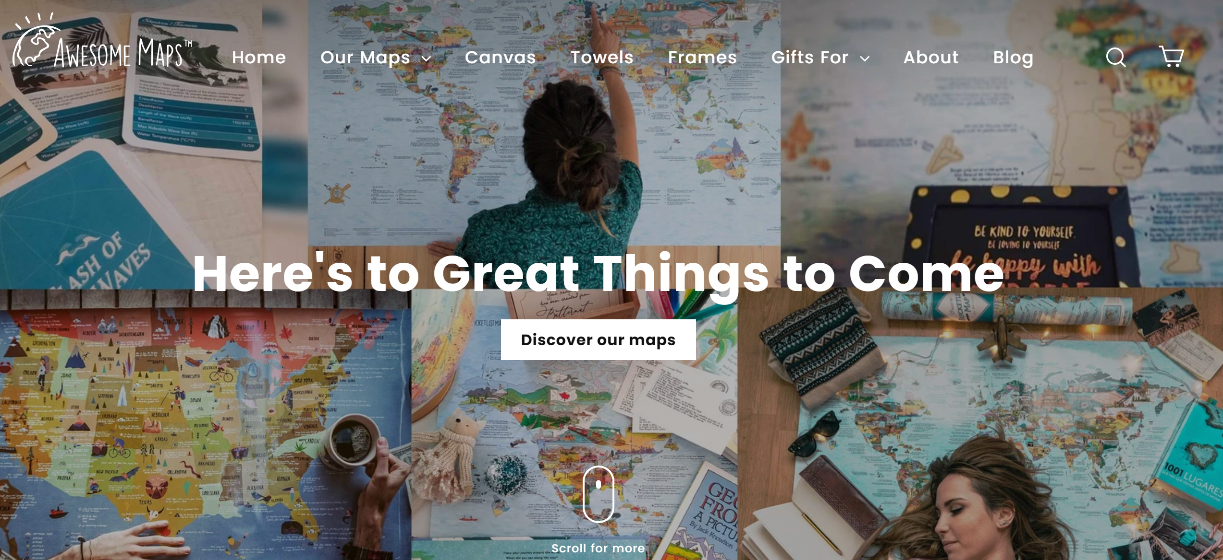
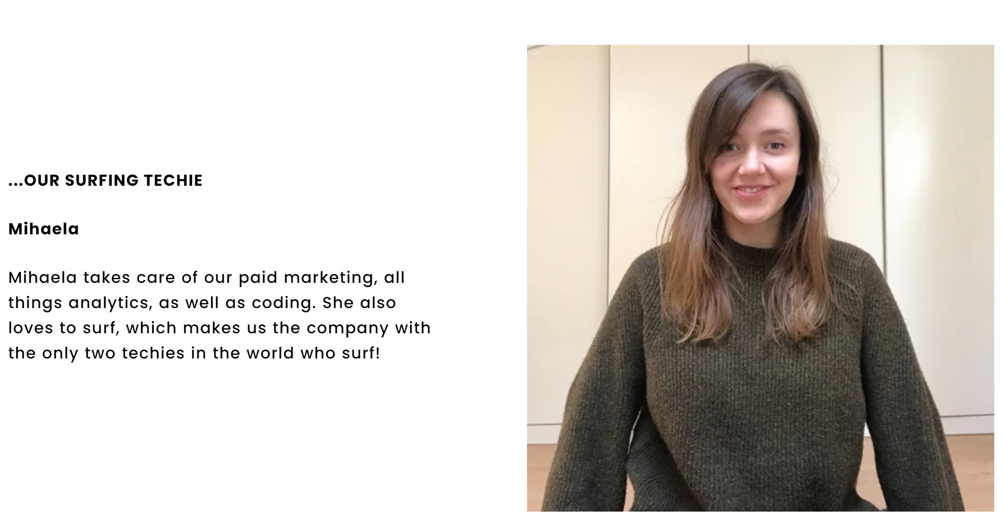
Stakeholder and Business Question
Stakeholder
Awesome Maps (Small Online Retailer)
Michaela – Manager for Paid Marketing
Sell custom maps for niche demographics
www.awesome-maps.com
Business Question
Which customer segments should Awesome Maps targets in their digital marketing campaign, and what is the expected improvement in their sales?

Slide 5
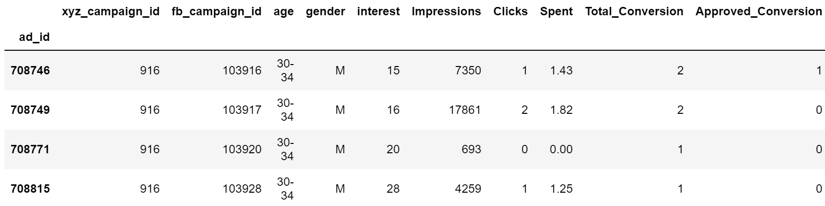
Dataset – Kaggle Sales Conversion Optimisation
Advertising ID
Campaign ID
Age of User
Gender
Interest of User
Impressions (Views)
Clicks
Cost/Ad
Approved Conversion (Sales)

Slide 6
EDA – Age and Gender
Equal mix of male and female views
Most views skewed towards 30-34 year old's

Slide 7
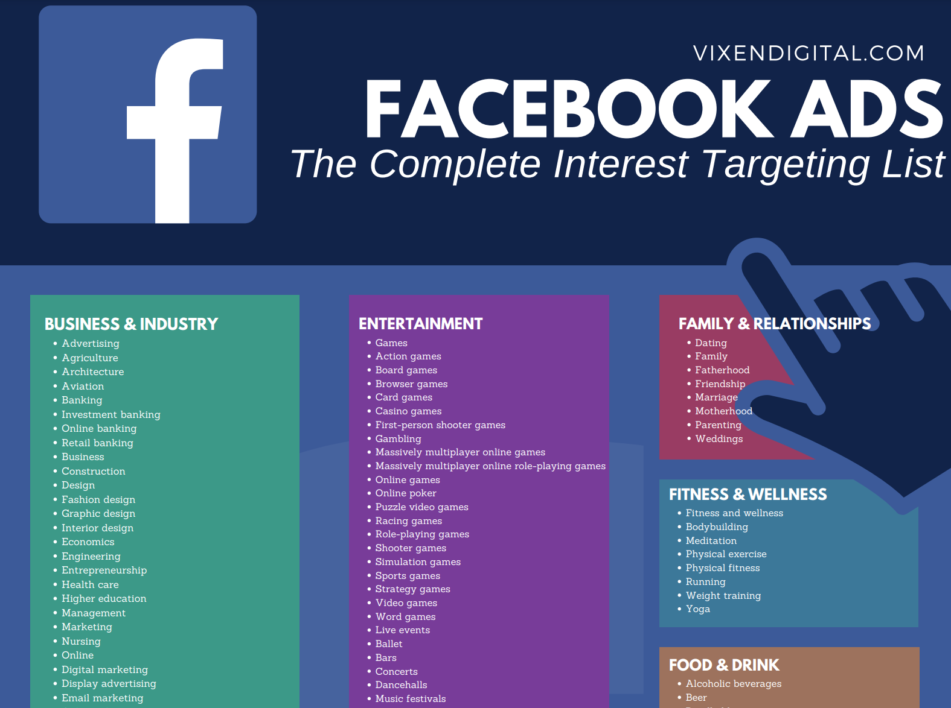
EDA– Interests
Interest of user

Slide 8
Marketing Strategy
Use clustering to define customer segments based on key features
Evaluate which customer segments provide the most ROI value
Cost per Conversion = Total Cost of Advertising/ Approved Conversions
Apply the advertising budget to target only high value customer segments
Calculate the % increase in sales
Notes:
Shane will now take us step by step through this model

Slide 9
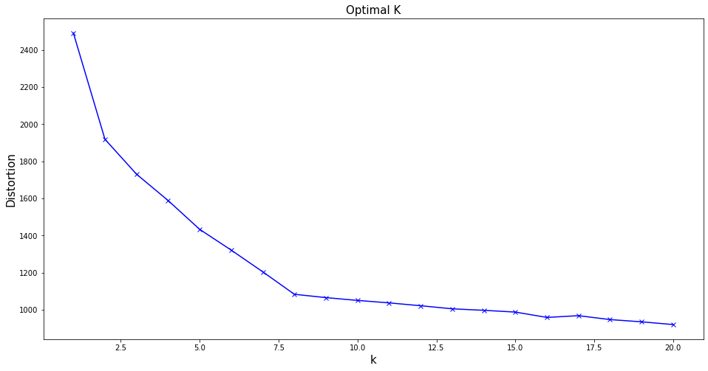
K Means Clustering
Chosen Features
Age
Gender
Interests (convert to dummy variables)
Choose K = 8
Kmeans score = -1082

Slide 10
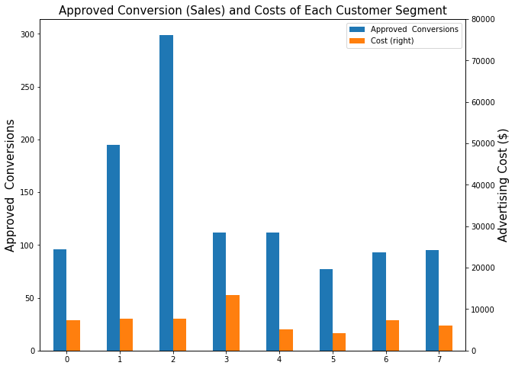
Customer Segments
Total ‘Approved Conversions’ (Sales) to each customer segment
Total cost of advertising to each customer segment
Prefer to target segments with sales but also need to minimise cost

Slide 11
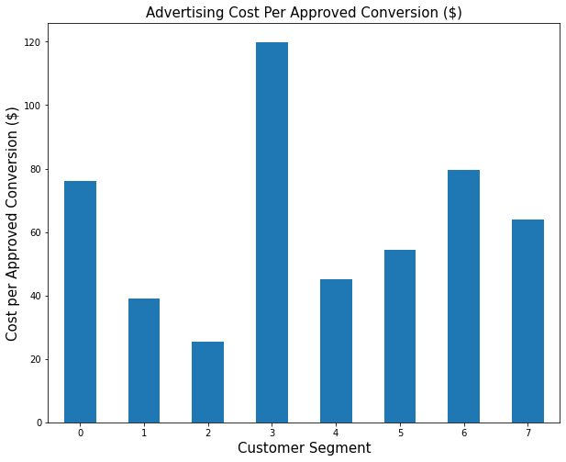
Customer Segments
Advertising Cost per Approved Conversion
Target customer segments with low cost/sale ratio
Choose Segments 2,1 and 4

Slide 12
Targeting Customer Segments
Customer Segment in order of Priority | Age | Gender | Facebook Interest Code
2 | 30-34 | M | 10,15,16,28,29
1 | 30-34 | F | 16,18,27,29,64
4 | 35-39 | M | 10,15,16,28,29

Slide 13
Cost/Conversion
Metric | Existing | With Customer Segmentation
Total Approved Conversions | 1079 | 606
Total Advertising Expenditure | $58,705 | $20,303
Cost/Conversion | $54.40 | $33.50

Slide 14
Return on Investment
Assumptions
Small online retailers have relatively infinite potential customer base from a global perspective
Sales will increase proportionally with more advertisements targeting key customer segments
Using advertising budget of $58,705
Cost/Conversion is $33.50
Total Conversions = 1752
Represents an improvement in sales of 62%

Slide 15
Conclusions and Future Actions
Business’s can reduce advertising cost / conversion by implementing customer segmentation
Approved conversions (Sales) can be increased through targeted advertising campaigns
Future - Can incorporate advertisement ID into model to potentially improve effectiveness

Slide 16
SN Marketing Sales Model
Show successful previous Facebook advertising campaign (Awesome Maps) increasing sales by 62%
Offer new clients 1 week of service for free
Fee will be based on a % of increased sales volume/revenue

Slide 17
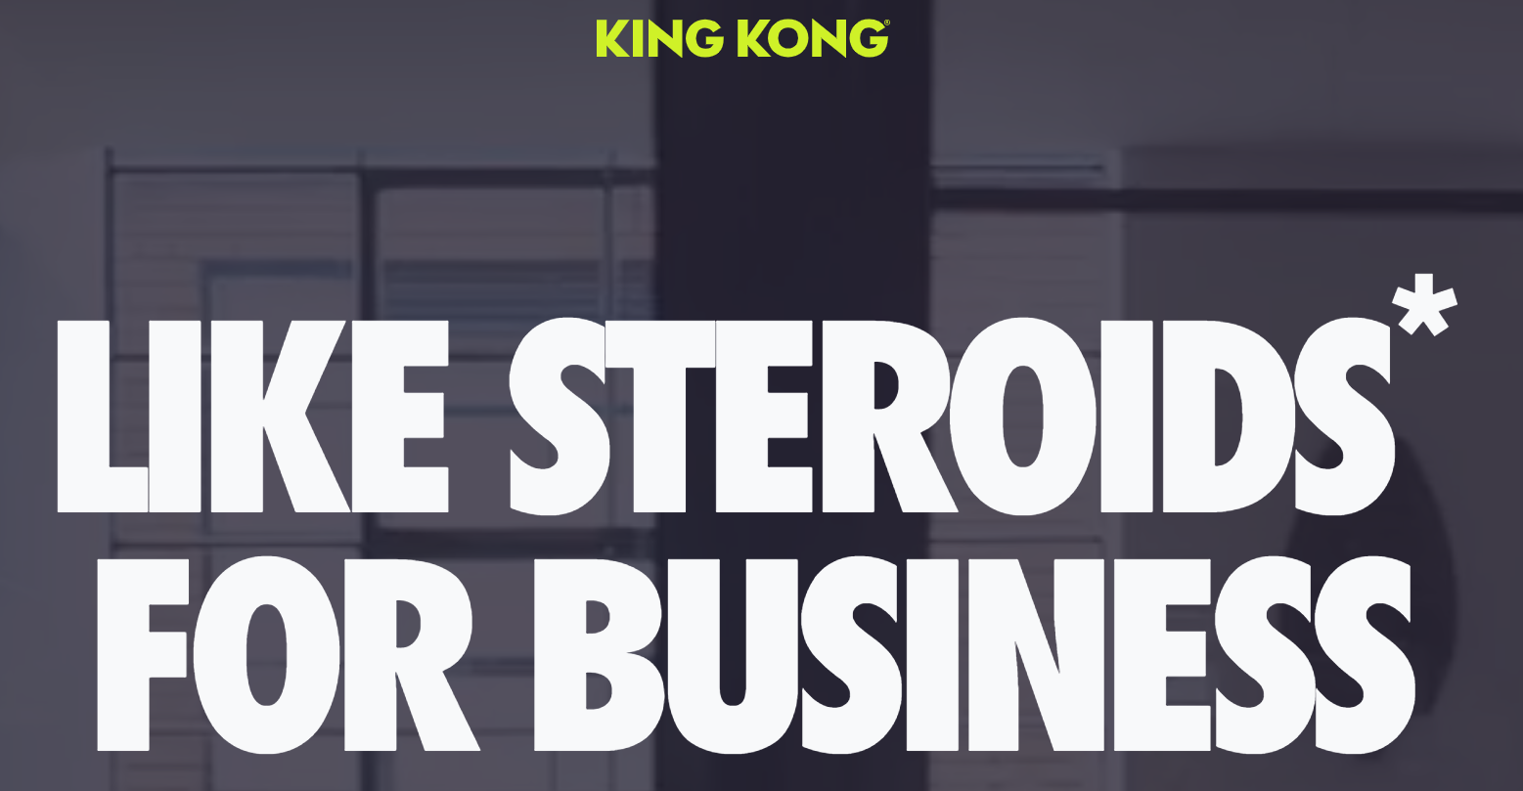
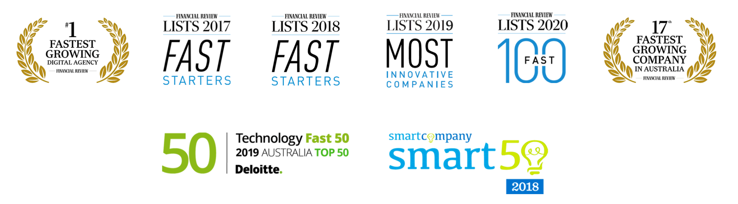
Business Environment – King Kong
Australia's Leading ROI-Driven Digital Agency
Highest growth digital marketing company in the last 4 years
They using ‘selling system’ for each industry
They work with small business’s to reach multi-million dollars
Their system includes rewriting the company’s Ads
They get paid from the EXTRA sales the companies make
They help small business to increase their conversation up to 400%

